Slide 1
Eclipse Plug-in Development
SWT/JFace Development Part 5
Dialogs, Wizards and Actions

Slide 2
Contents
Dialogs in SWT/JFace
SWT Dialogs
JFace Dialogs
Wizards
Wizard Page
Action
Actions
Contribution Item
Menu Manager
ToolBar contribution item

Slide 3
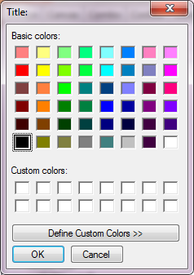
SWT Dialogs
ColorDialog
ColorDialog dialog = new ColorDialog(shell);
dialog.setRGB(new RGB(0, 125, 0));
RGB result = dialog.open();

Slide 4
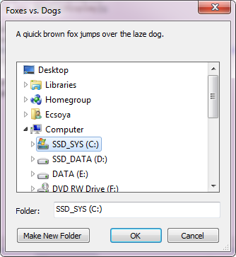
SWT Dialogs
DirectoryDialog
DirectoryDialog dialog = new DirectoryDialog(shell);
dialog.setText("Foxes vs. Dogs");
dialog.setMessage("A qiuick brown fox jumps over the laze dog.");
dialog.setFilterPath("C:");
String open = dialog.open();

Slide 5
SWT Dialogs
FileDialog
Open
FileDialog openDialog = new FileDialog(shell, SWT.OPEN | SWT.MULTI);
openDialog.setText("Open File Dialog");
openDialog.setFilterExtensions(new String[] { "*.jpg;*.png;*.gif",
"*.*" });
openDialog.setFilterPath("C:");
String open = openDialog.open();

Slide 6
SWT Dialogs
FileDialog
Save
FileDialog saveDialog = new FileDialog(shell, SWT.SAVE);
saveDialog.setText("Save File Dialog");
saveDialog.setFilterExtensions(new String[] { "*.txt" });
saveDialog.setFileName("new_file");
saveDialog.setFilterPath("C:");
saveDialog.setOverwrite(true);
saveDialog.open();

Slide 7
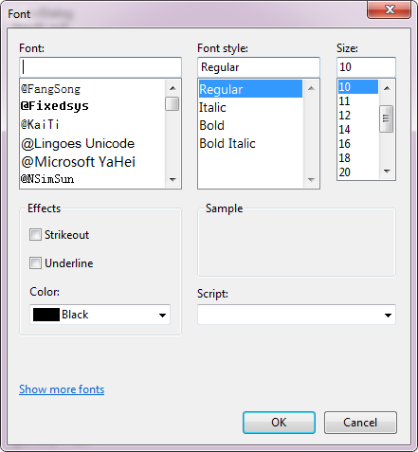
SWT Dialogs
FontDialog
FontDialog dialog = new FontDialog(shell);
dialog.setEffectsVisible(true);
FontData open = dialog.open();

Slide 8
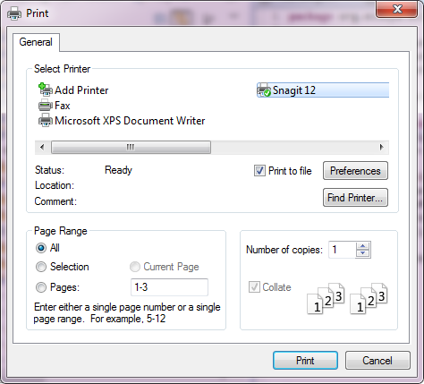
SWT Dialogs
PrintDialog
PrintDialog dialog = new PrintDialog(shell);
dialog.setStartPage(1);
dialog.setEndPage(3);
dialog.setPrintToFile(true);
dialog.open();

Slide 9
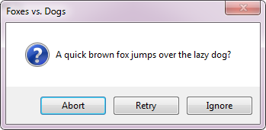
SWT Dialogs
MessageBox
ICON_ERROR, ICON_INFORMATION, ICON_QUESTION, ICON_WARNING, ICON_WORKING
OK, OK | CANCEL
YES | NO, YES | NO | CANCEL
RETRY | CANCEL
ABORT | RETRY | IGNORE
MessageBox box = new MessageBox(shell, SWT.RETRY | SWT.IGNORE
| SWT.ABORT | SWT.ICON_QUESTION);
box.setText("Foxes vs. Dogs");
box.setMessage("A quick brown fox jumps over the lazy dog?");
int result = box.open();

Slide 10
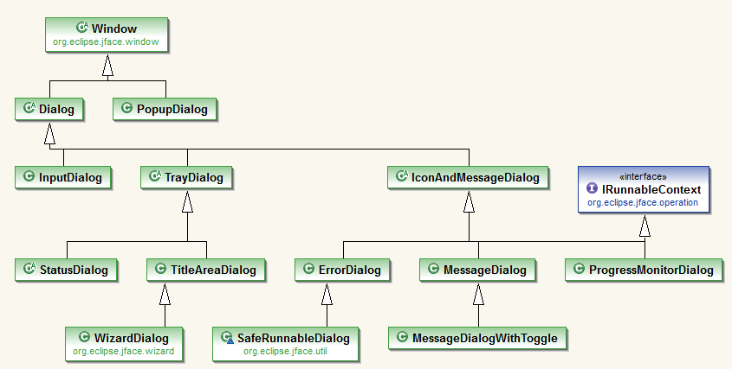
JFace Dialogs

Slide 11
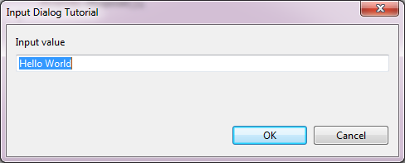
JFace Dialogs
InputDialog
InputDialog inputDialog = new InputDialog(shell,
"Input Dialog Tutorial", "Input value", "Hello World", null);
inputDialog.open();

Slide 12
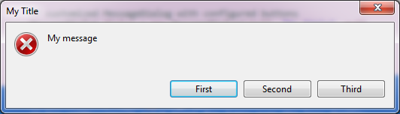
JFace Dialogs
Message Dialog
MessageDialog.openConfirm(shell, "Confirm", "Please confirm");
MessageDialog.openError(shell, "Error", "Error occured");
MessageDialog.openInformation(shell, "Info", "Info for you");
MessageDialog.openQuestion(shell, "Question", "Really, really?");
MessageDialog.openWarning(shell, "Warning", "I am warning you!");
MessageDialog dialog = new MessageDialog(shell, "My Title", null,
"My message", MessageDialog.ERROR, new String[] { "First",
"Second", "Third" }, 0);
int result = dialog.open();
System.out.println(result);

Slide 13
JFace Dialogs
ErrorDialog
ErrorDialog.openError(shell, “title”, “message”, IStatus );
ErrorDialog.openError(shell, “title”, “message”, IStatus, displayMask);

Slide 14
JFace Dialogs
Extending Dialog
public class Dialog1 extends Dialog {…}
protected Control createDialogArea(Composite parent) {
return super.createDialogArea(parent);
}
protected void configureShell(Shell newShell) {
super.configureShell(newShell);
}
protected Point getInitialSize() {
return super.getInitialSize();
}

Slide 15
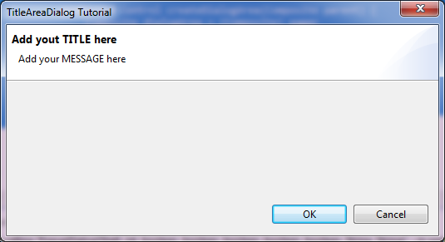
JFace Dialogs
TitleAreaDialog
TitleAreaDialog dialog = new TitleAreaDialog(shell) {
protected void configureShell(Shell newShell) {
super.configureShell(newShell);
newShell.setText("TitleAreaDialog Tutorial");
}
protected Control createDialogArea(Composite parent) {
Composite dialogArea = (Composite) super
.createDialogArea(parent);
// add your contents here
setTitle("Add yout TITLE here");
setMessage("Add your MESSAGE here");
return dialogArea;
}
};
dialog.open();

Slide 16
JFace Dialogs
WizardDialog dialog = new WizardDialog(shell, new MyWizard());
dialog.open();
WizardDialog
Wizard
Wizard Page
public class MyWizard extends Wizard {
public MyWizard() {
setWindowTitle("Wizard Dialog Tutorial");
}
public void addPages() {
addPage(new WizardPage1());
}
public boolean performFinish() {
return false;
}
}
public class WizardPage1 extends WizardPage {
protected WizardPage1() {
super("WizardPage1");
}
public void createControl(Composite parent) {
Label control = new Label(parent, SWT.NONE);
control.setText("Page1");
setControl(control);
setTitle("Page1 Title");
setMessage("Page1 Message");
}
}

Slide 17
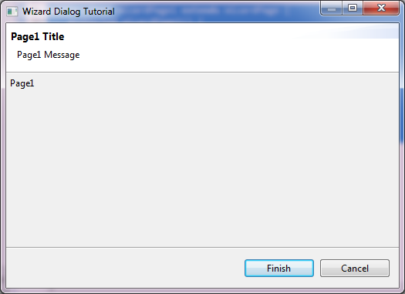
JFace Dialogs
WizardDialog
Wizard
Wizard Page

Slide 18
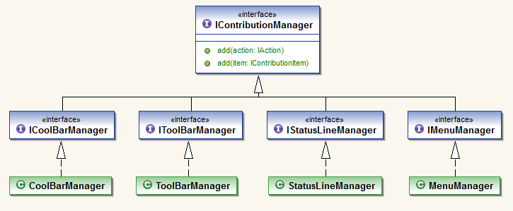
JFace Actions
Contribution Manager

Slide 19
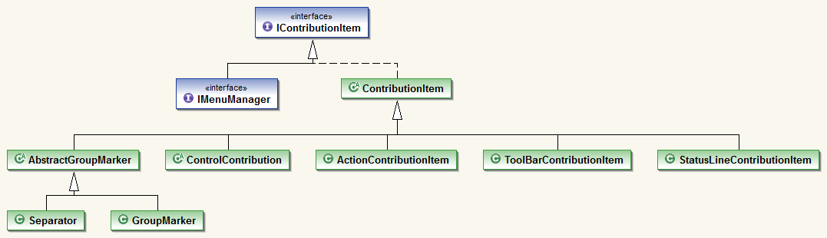
JFace Actions
Contribution Item

Slide 20
JFace Actions
IAction
Styles:
AS_UNSPECIFIED
AS_PUSH_BUTTON
AS_CHECK_BOX
AS_DROP_DOWN_MENU
AS_RADIO_BUTTON
text
imageDescriptor
toolTipText
run()

Slide 21
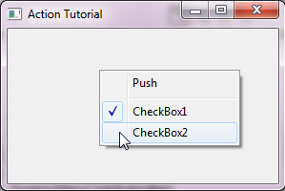
JFace Actions
Example
MenuManager manager = new MenuManager();
manager.add(new Action("Push", IAction.AS_PUSH_BUTTON) {
});
manager.add(new Separator());
manager.add(new Action("CheckBox1", IAction.AS_CHECK_BOX) {
});
manager.add(new Action("CheckBox2", IAction.AS_CHECK_BOX) {
});
Menu menu = manager.createContextMenu(shell);
shell.setMenu(menu);

Slide 22
Any Questions?
Skype: jin.liu.soyatec
Email: jin.liu@soyatec.com

Slide 23
The end

